Slide 1

PORTABLE NON-INVASIVE EYE PRESSURE MONITORING DEVICE
Team Name :Electrontwerpers
Team Member: Reshma N, Rohith M, Sabareesan K.S, Sachin K,
Ranjith Kumar R
"Don’t Let Glaucoma Steal Your Vision!"
Glauco Tracker

Slide 2
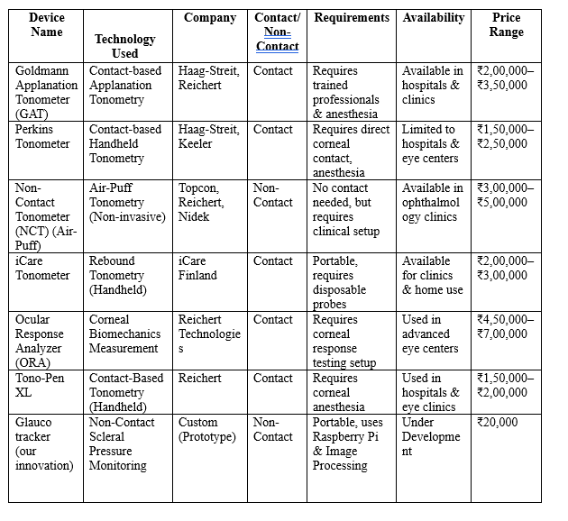
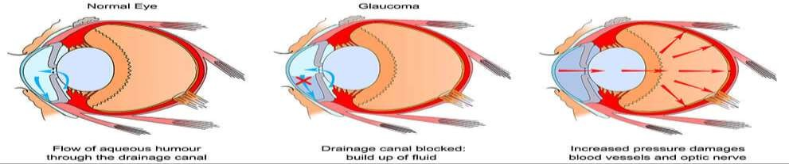
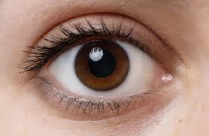
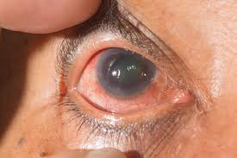
PROBLEM STATEMENT
TEAM NAME :Electrontwerpers
CORE PROBLEM
Existing Solutions
Glaucoma, a leading cause of irreversible blindness, requires regular intraocular pressure (IOP) monitoring, but current methods are expensive, contact-based, and inaccessible for many patients.
Why It’s Urgent:
80+ million people worldwide suffer from glaucoma (WHO, 2023).
50% of cases go undiagnosed, rising to 90% in developing countries.
By 2040, cases will reach 111 million, increasing the burden on healthcare.
Glaucoma is a progressive eye disease that leads to irreversible blindness if not detected early.
Normal
Glaucoma
Fig 1 : Existing solution
2

Slide 3
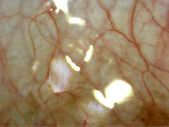
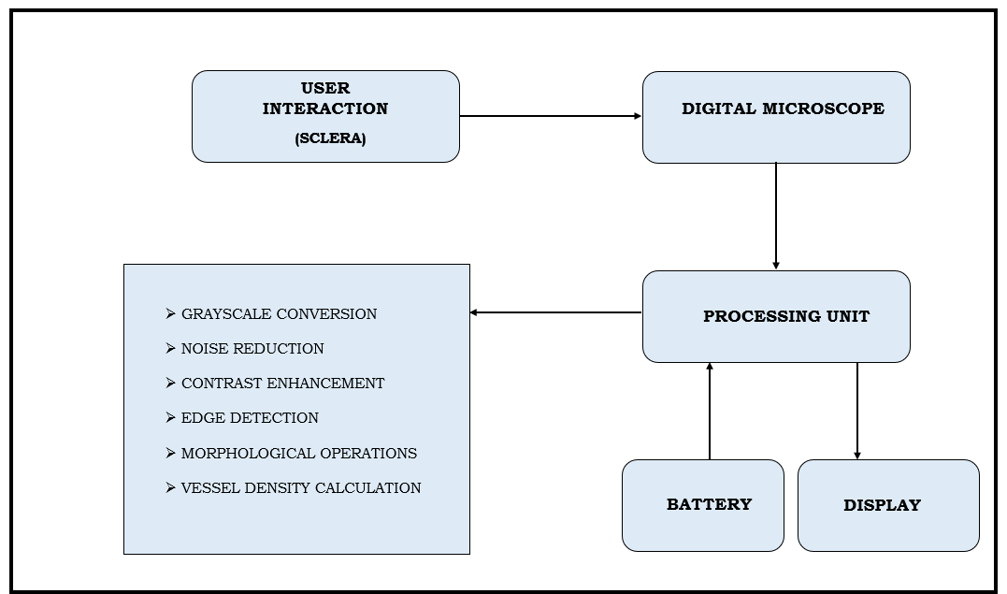
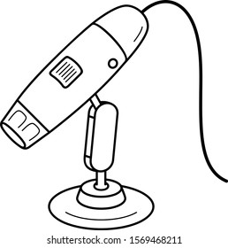
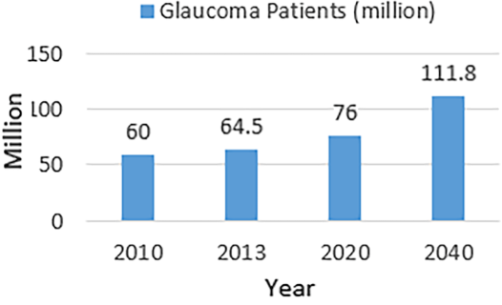
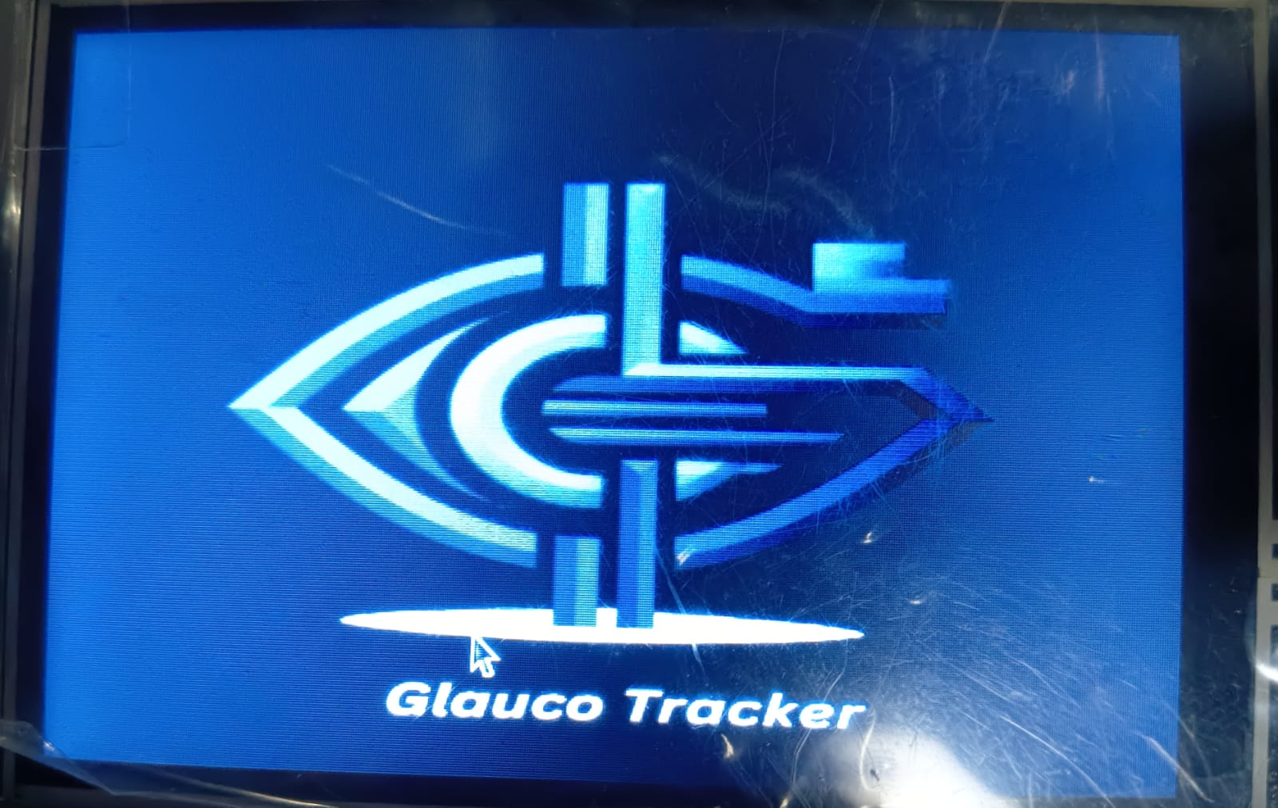
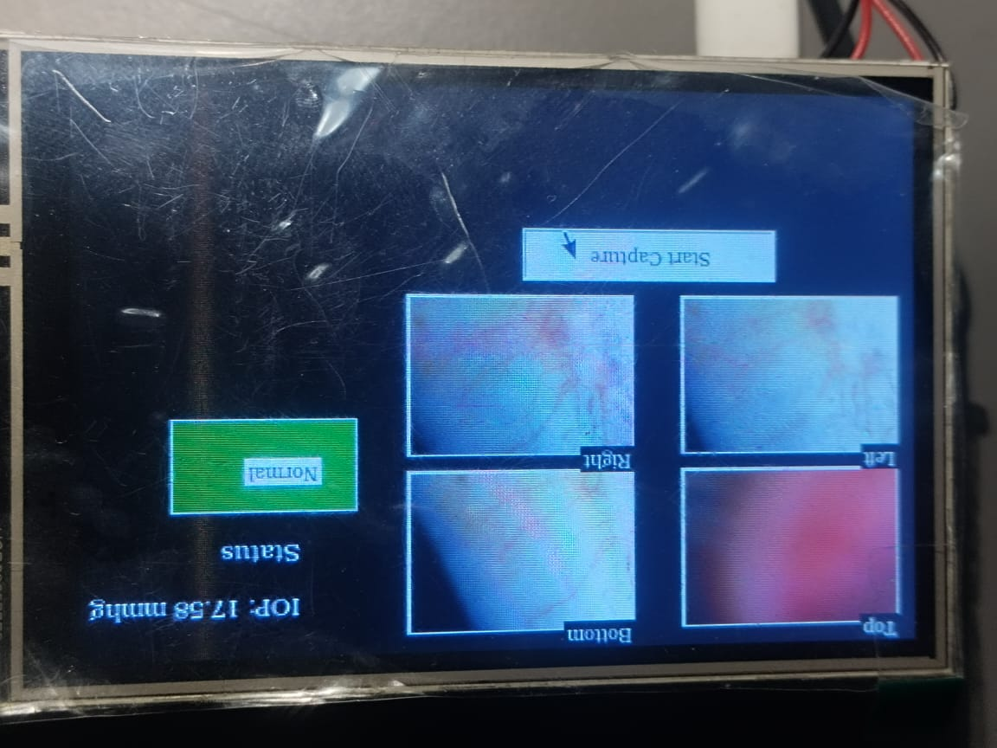
TEAM NAME :Electrontwerpers
PROPOSED SOLUTION
The proposed AI-driven portable device captures scleral images using a digital microscope for non-contact intraocular pressure (IOP) monitoring. The processing unit applies deep learning techniques like edge detection, morphological operations, and vessel density calculation to estimate IOP accurately. The results are displayed in real-time.
Key Benefits & Impact:
Non-Contact & Painless
Portable & User-Friendly
Accurate & Reliable
Reduces Hospital Visits
Smart Integration
Fig 3 : Flowcharts
Fig 2 : Working flow
Unique Selling Proposition: Portable & User-Friendly , Affordable & Scalable .
3

Slide 4
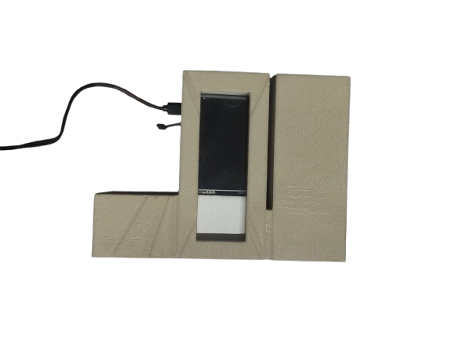
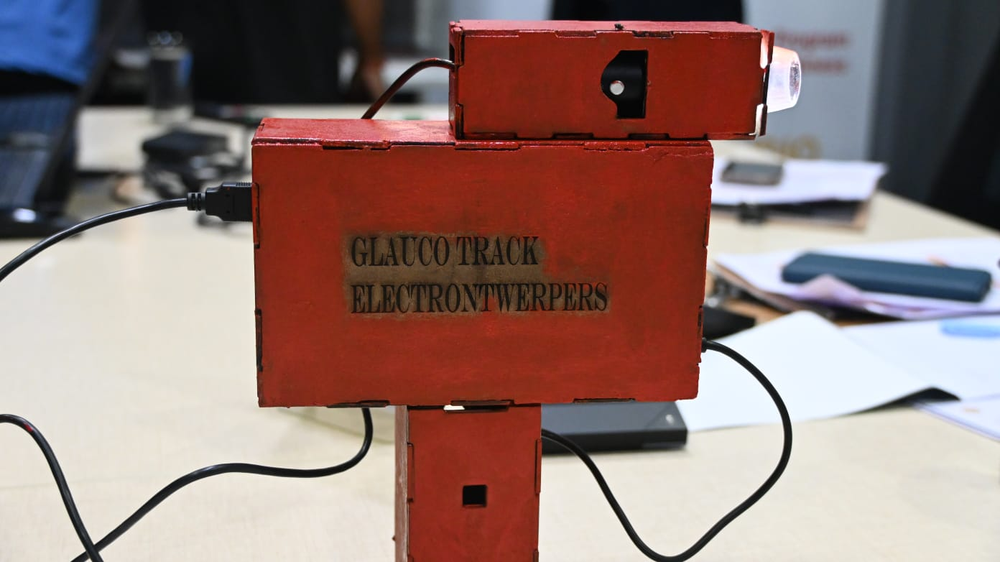
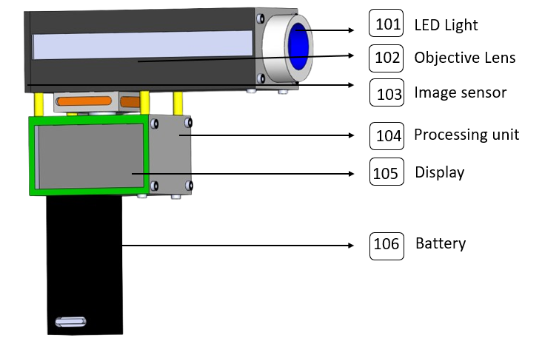
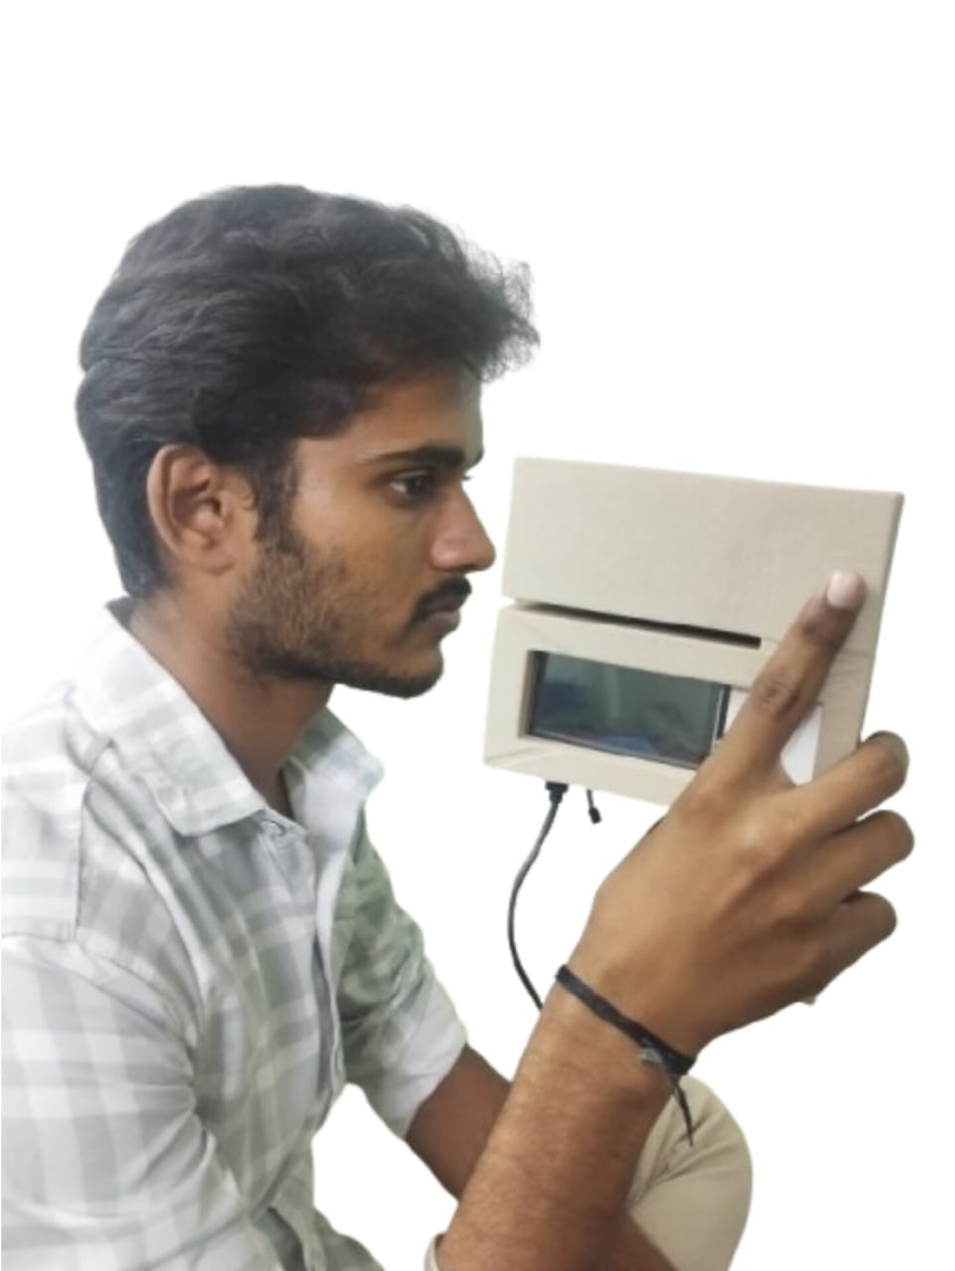
TEAM NAME :Electrontwerpers
CURRENT STATUS
Fig 4 : Product development status
4

Slide 5
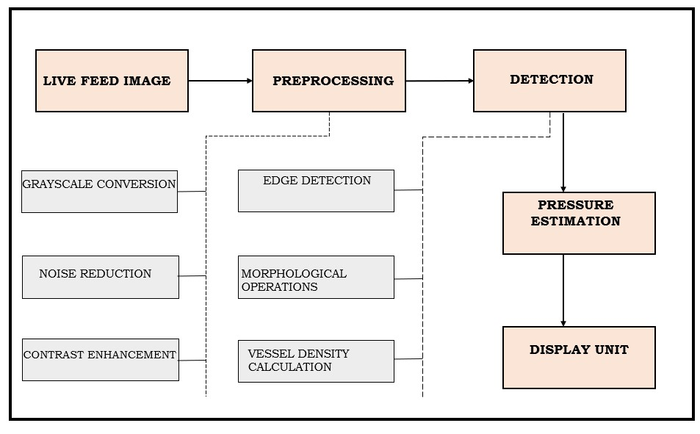
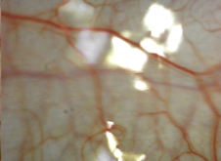

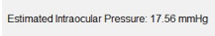
TEAM NAME :Electrontwerpers
AI Technology
How It Works:
Live Camera Feed: Captures real-time images of the sclera using a webcam. Preprocessing: Enhances contrast, reduces noise, and applies edge detection to highlight blood vessels. Vessel Segmentation: Uses morphological operations to extract vascular structures from the image. Real-Time Visualization: Displays processed images .
Fig 5 : Working flow
Fig 6 : Flowcharts
Normal Eye
Image Enhanced Eye
Grayscale image
Edge detection
Advantages Over Traditional Approaches : Non-Invasive & Real-Time, Enhances Early Diagnosis, User-Friendly Interface
5

Slide 6
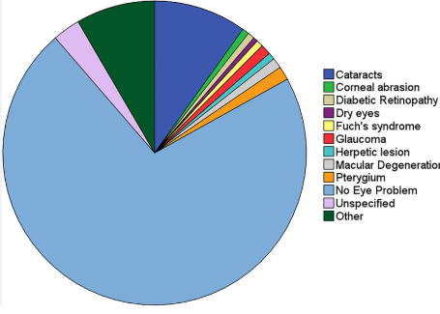




TEAM NAME :Electrontwerpers
MARKET OPPORTUNITY
Market Size & Growth Potential:
Glaucoma affects 80M+ people globally, rising to 111M by 2040.
The global glaucoma market will reach $12B by 2027 (CAGR: 6.8%).
India alone has 12M+ cases, with 90% undiagnosed, proving high demand for home-based solutions.
Target Market:
Glaucoma patients needing frequent IOP monitoring. Doctors & clinics requiring non-contact screening tools. Elderly & at-risk individuals who struggle with hospital visits.
Fig 7 : Market size
Customer Segments:
✔ Elderly patients – Need easy-to-use monitoring tools. ✔ Busy professionals – Prefer home-based solutions. ✔ Rural communities – Lack access to frequent screenings.
B2B & B2C Potential:
B2B: Hospitals, eye clinics, research institutions, and telemedicine platforms can integrate our solution.
B2C: Direct-to-consumer sales for people at risk of glaucoma, offering a home-based screening tool.
6

Slide 7
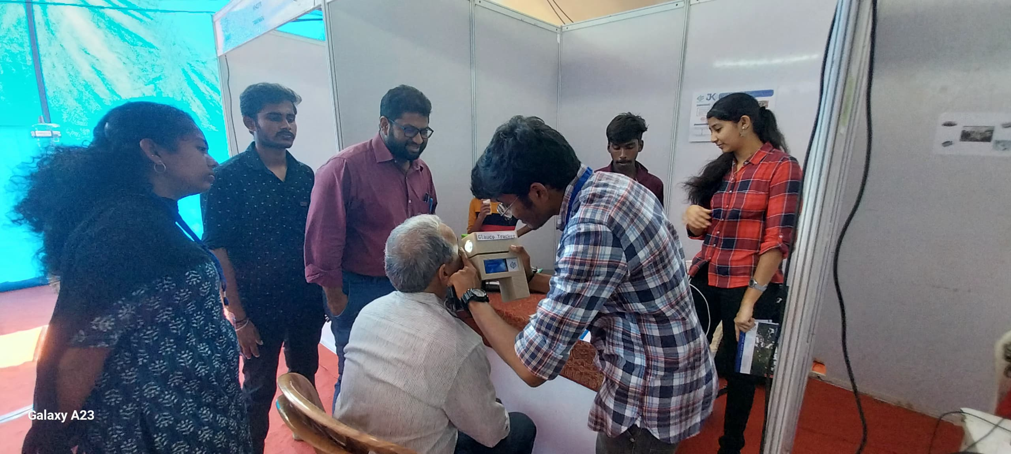
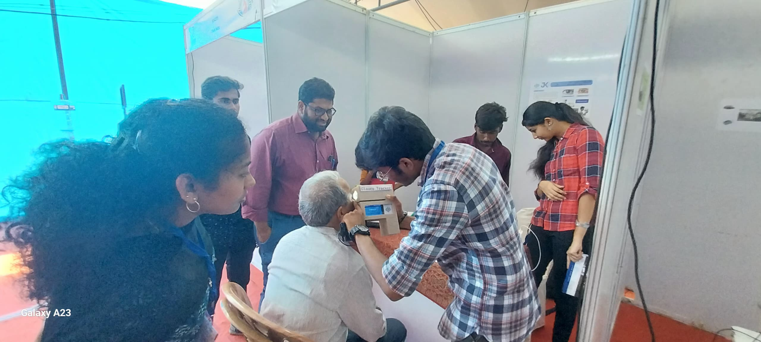
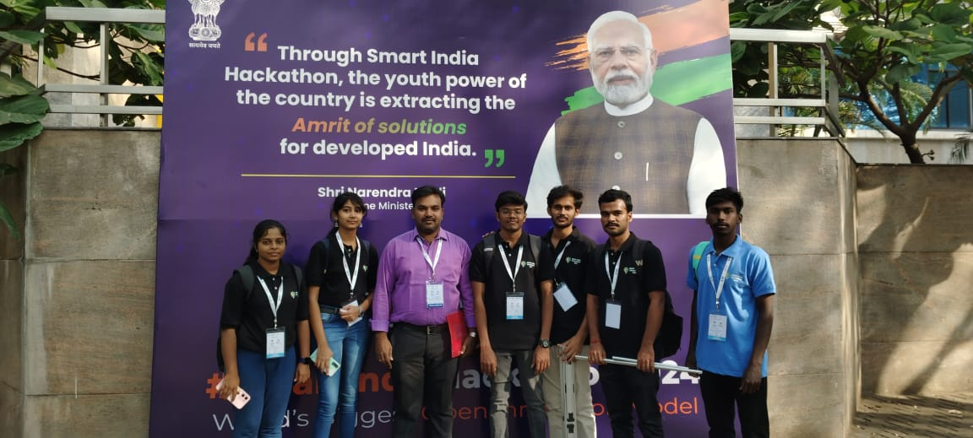
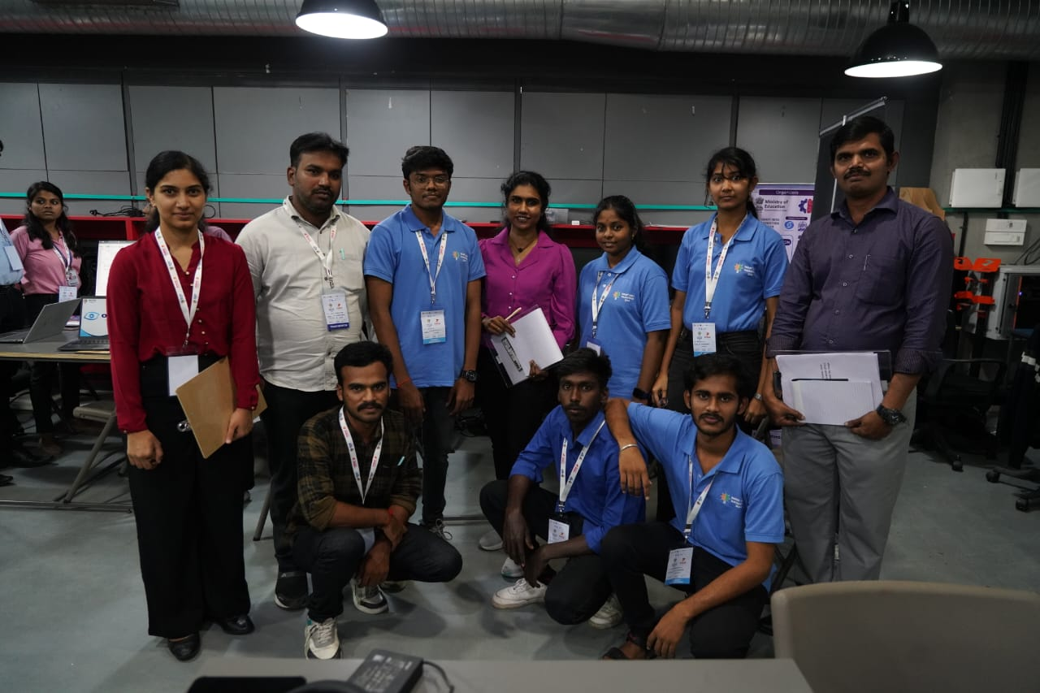
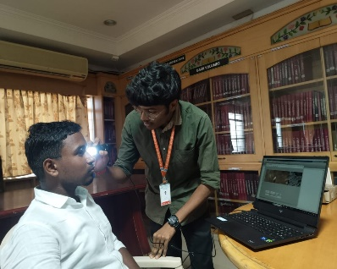
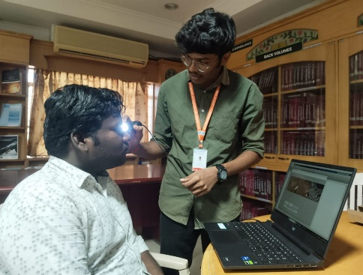
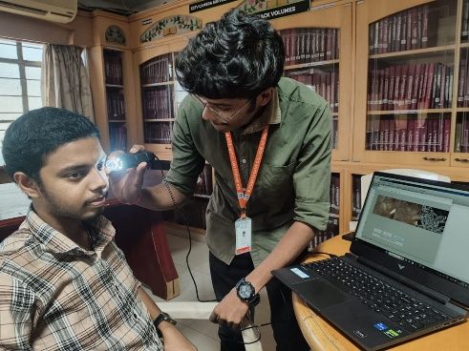
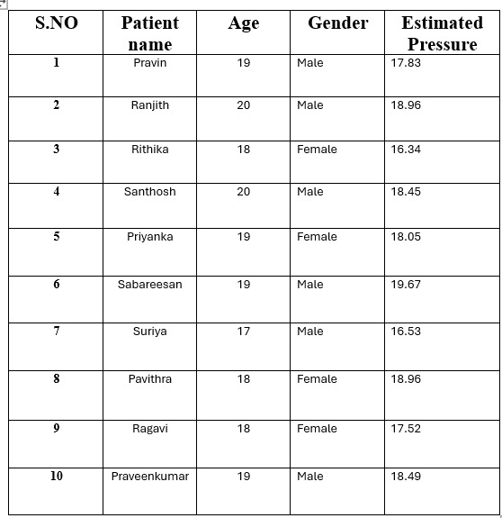
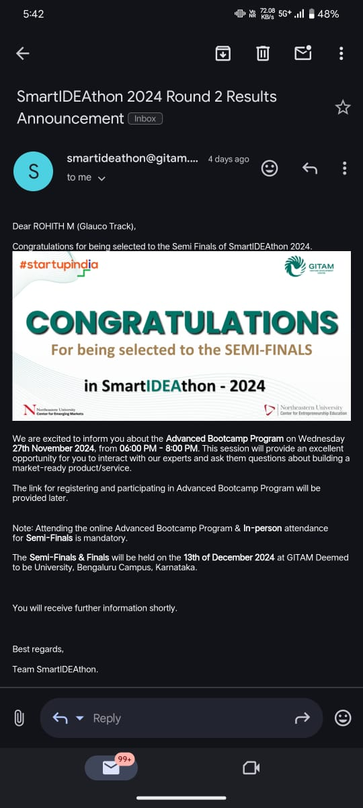
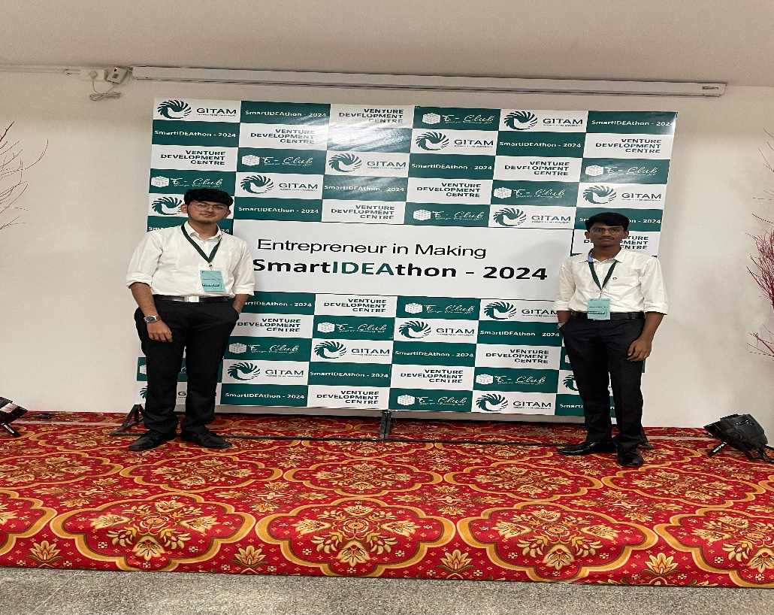
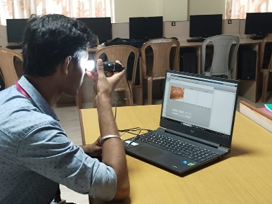
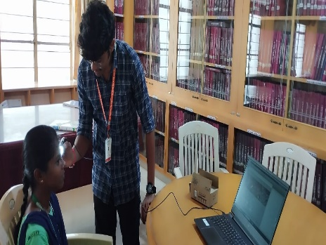
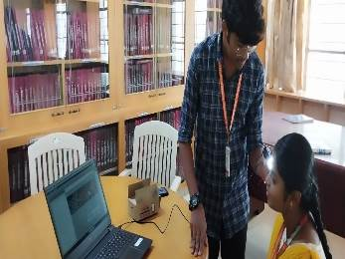

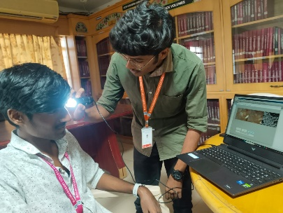
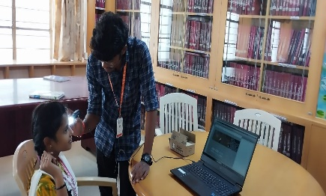
TEAM NAME :Electrontwerpers
TRACTION AND PROGRESS
Prototype Development
Hackathon Participation :
SIH – 2024
Survey Taken :
SmartIDEAthon - 2024
Srishti -2025
(With cash prize 12,000)
7

Slide 8
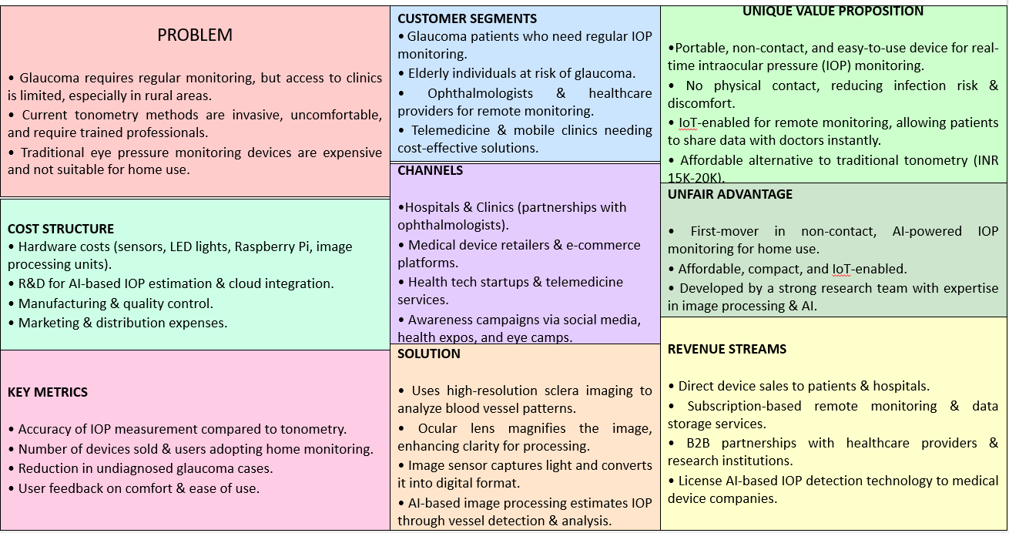
TEAM NAME :Electrontwerpers
BUSINESS AND REVENUE MODEL
8

Slide 9
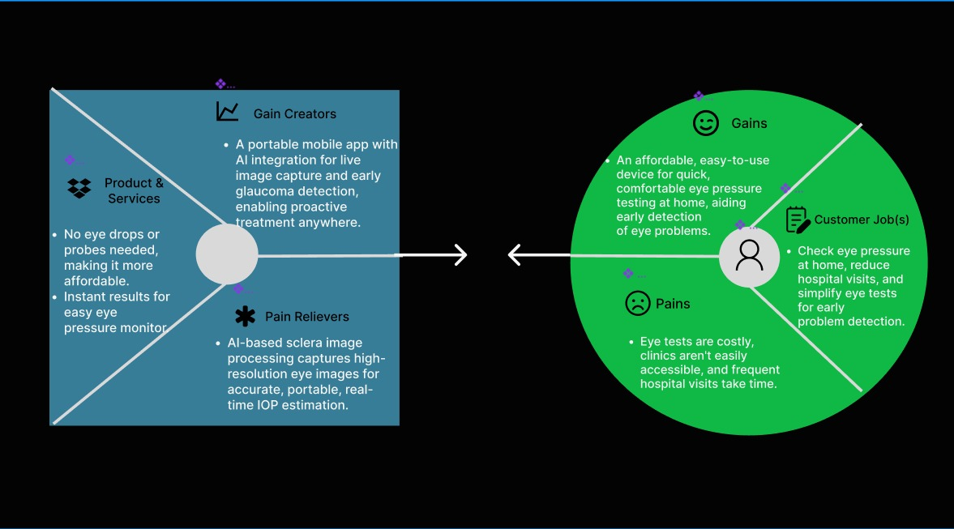
TEAM NAME :Electrontwerpers
MARKETING AND SALES
EXECUTION
9

